Slide 1
Differential programming demo
Background
Using Zygote
Simple functions
Toy problems

Slide 2
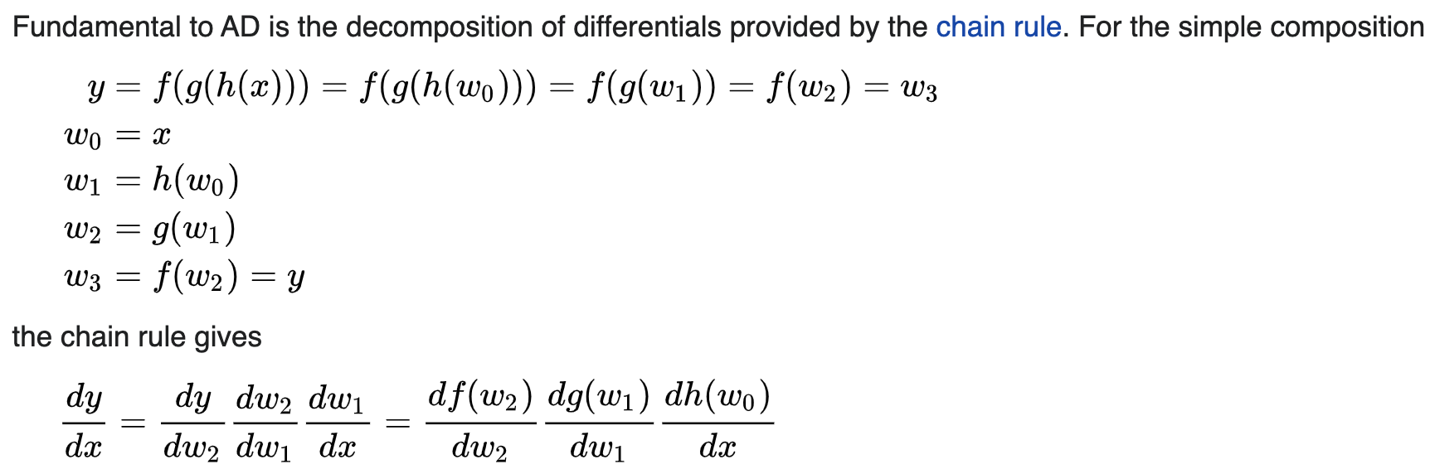
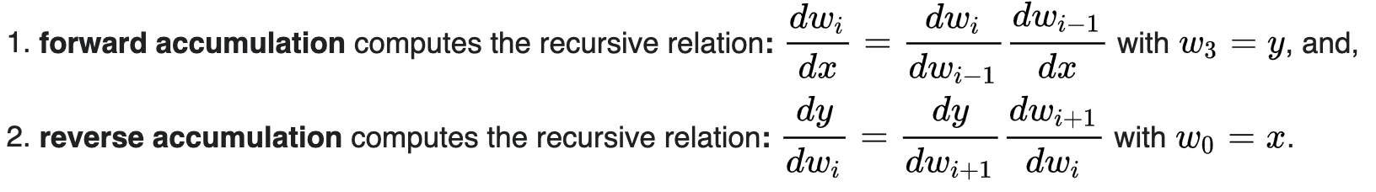
Intro (Wiki)
Code as composition of simple elementary operations and functions
Accurate to working precision

Slide 3
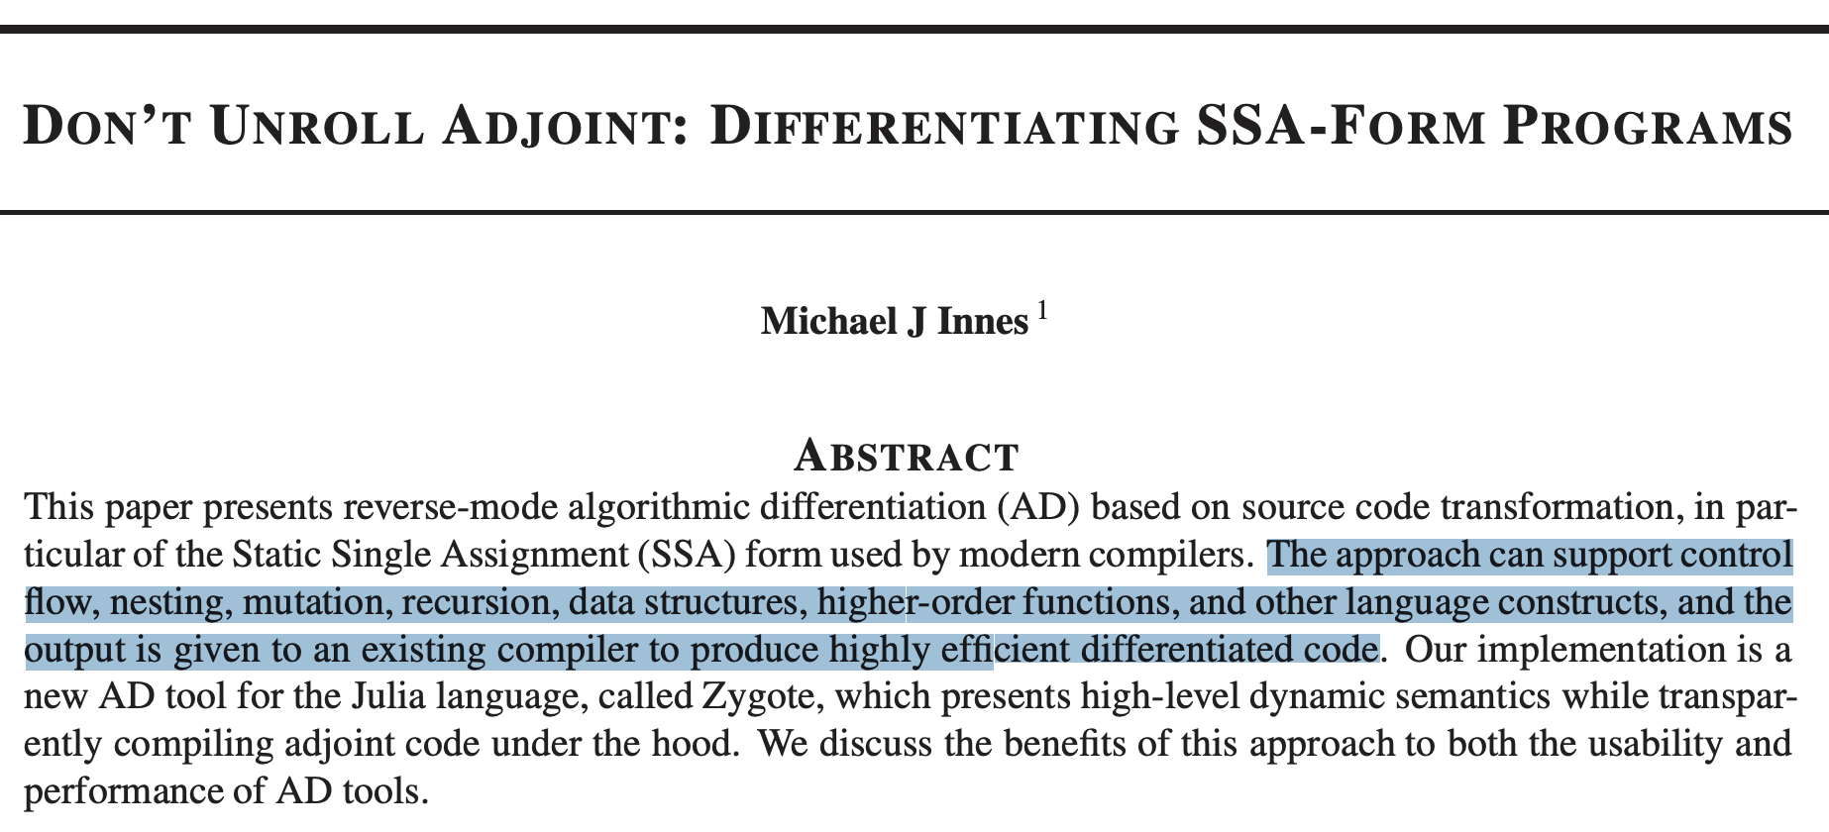
Zygote

Slide 4
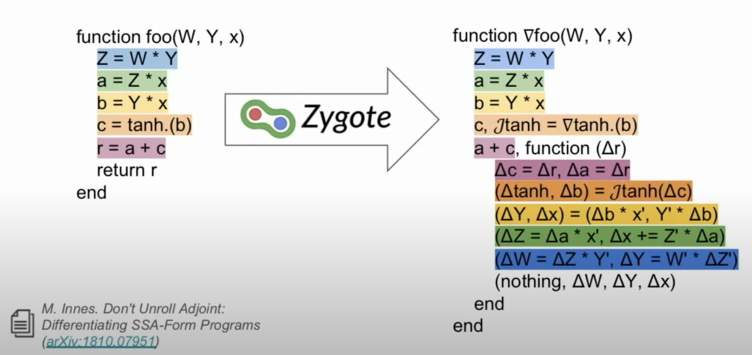
Source code transformation

Slide 5
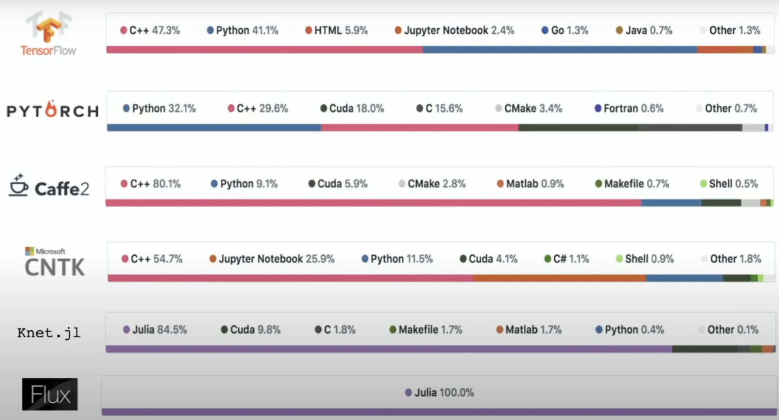
Comparison

Slide 6
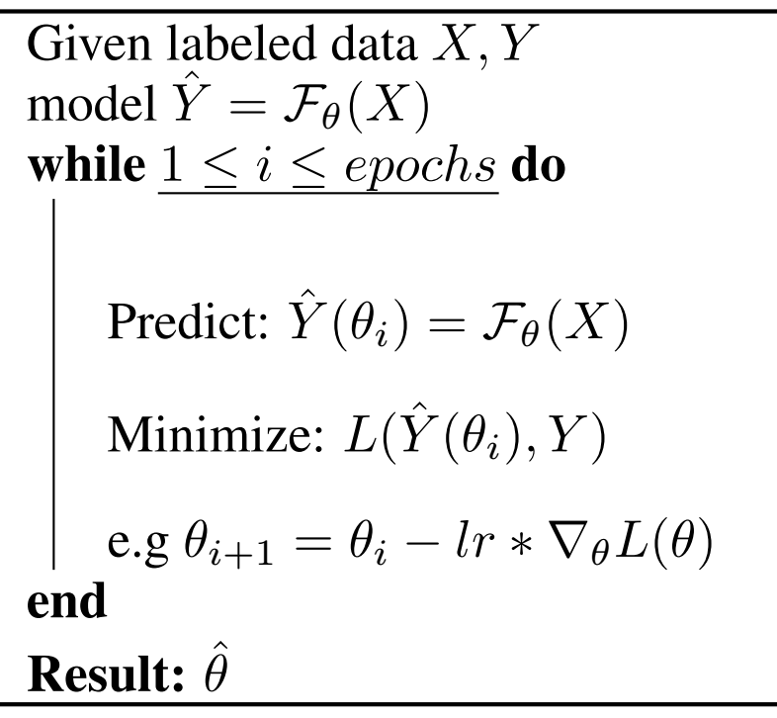
A supervised learning approach

Slide 7
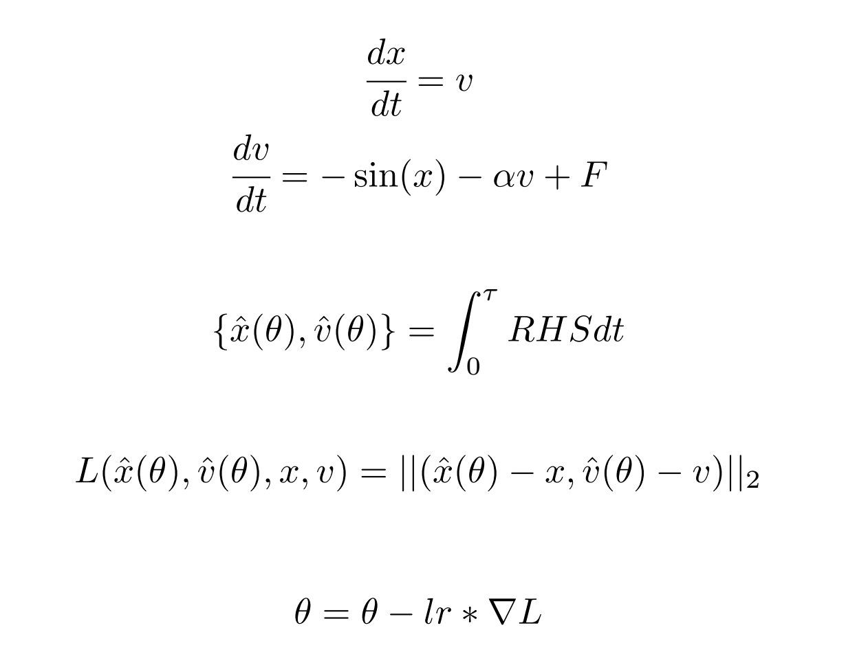
Pendulum Example

Slide 8
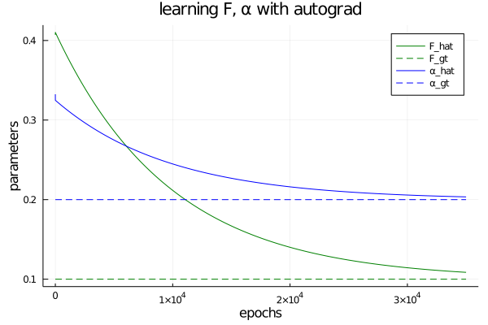
Two parameters

Slide 9
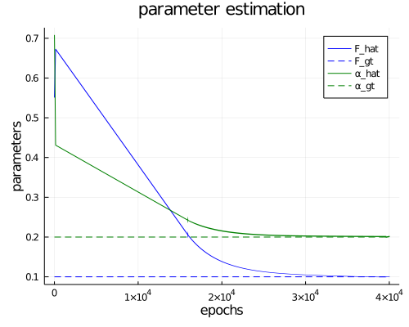
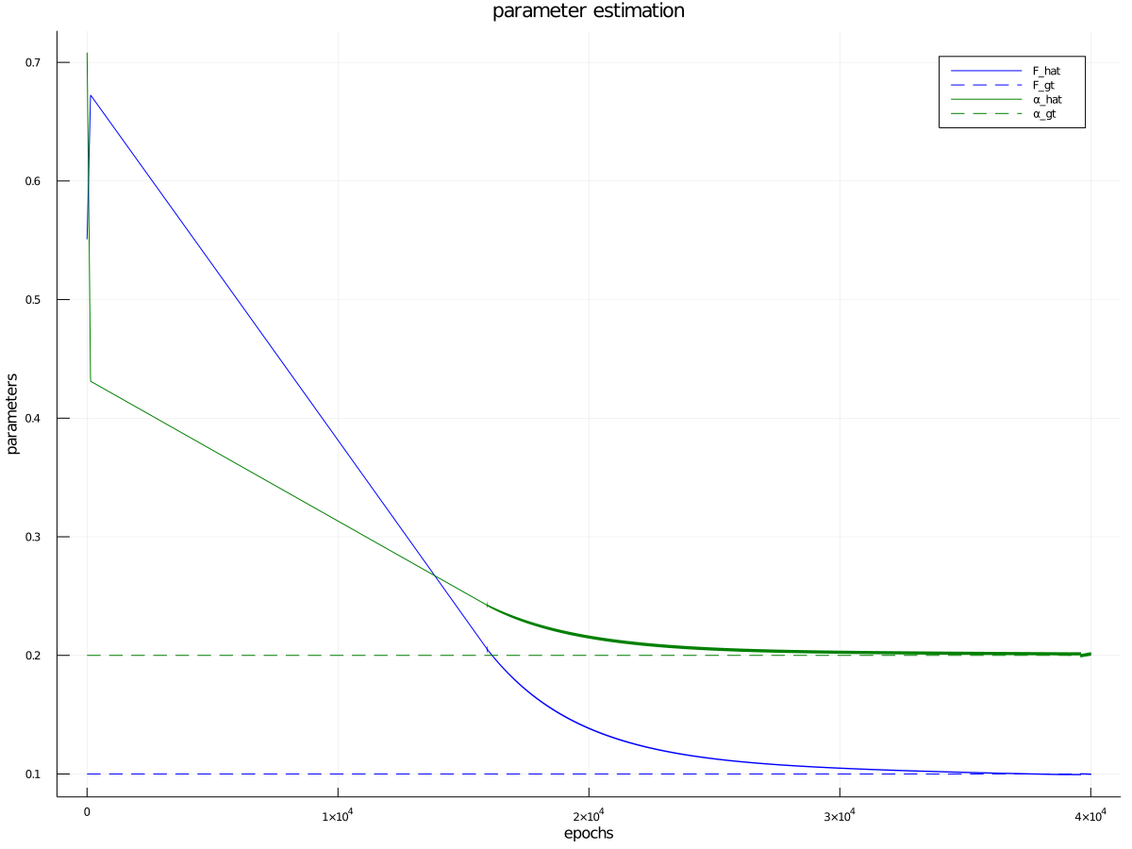
Analytic method (two params)

